Slide 1
Water System Infrastructure Improvements Merrimack Village District PFAS Treatment and CIP Wells 2, 3, 7 & 8
October 23, 2019

Slide 2
Introductions
Don Provencher
Chair, Board of Commissioners
Ron Miner
Superintendent, MVD
Jill Lavoie
Business Manager, MVD
Keith Pratt
President, Underwood Engineers, Inc.
Mike Metcalf
Sr. Project Manager, Underwood Engineers, Inc.

Slide 3
Agenda
Background
Wells #4 and #5 Update
Wells #7 and #8
Wells #2 and #3
Challenges and Opportunities
Questions and Answers

Slide 4
Background

Slide 5
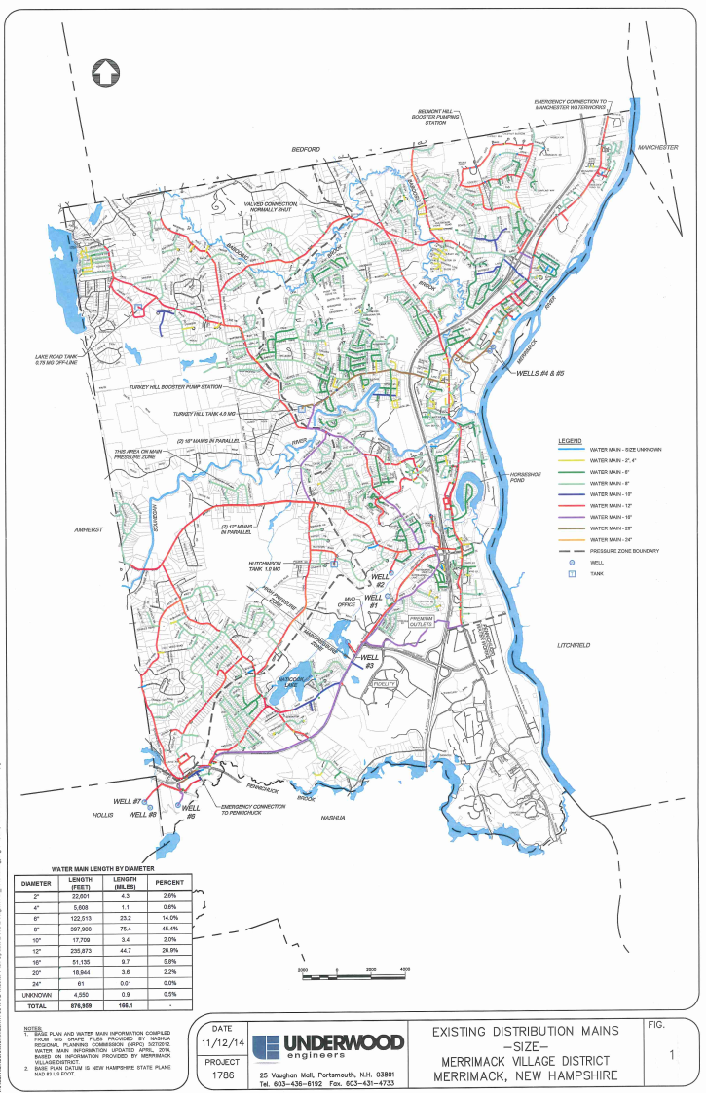
P
T
W
W
T
P
166 Miles of Piping
6 wells
1 treatment plant
3 pumping stations
3 tanks
T
W
W
~$175 Million in Assets
TP
P
W
W

Slide 6
P
T
W
W
TP
T
P
P
T
W
TP
W
$20+ Million Investment
TP
TP
P
W
W

Slide 7
Wells #4 and #5

Slide 8
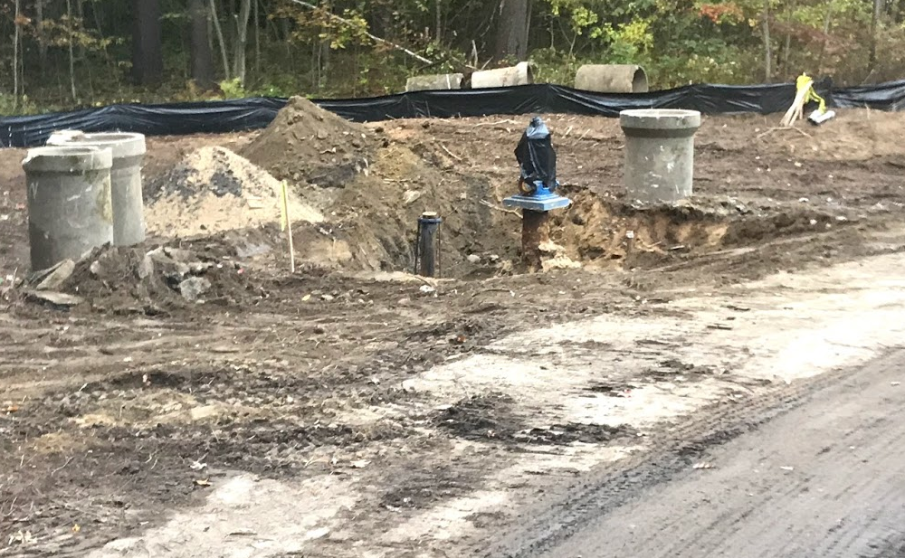

Slide 9
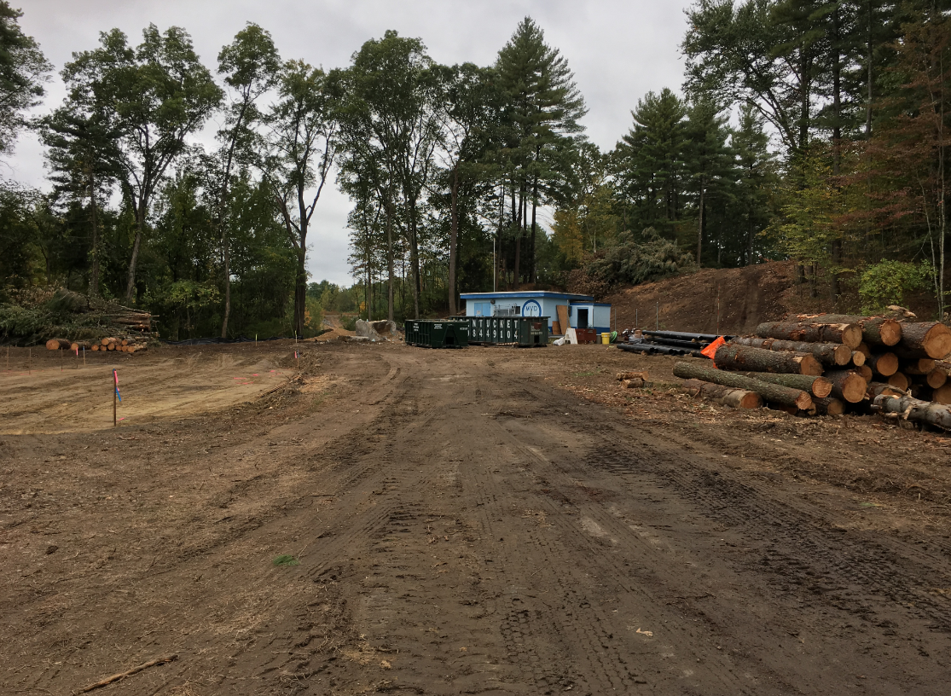

Slide 10
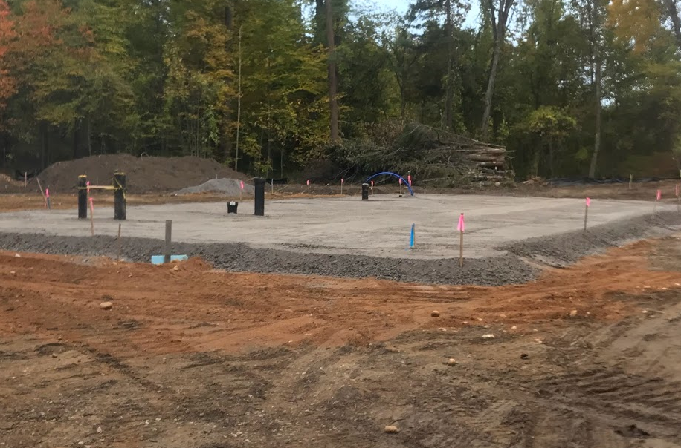

Slide 11
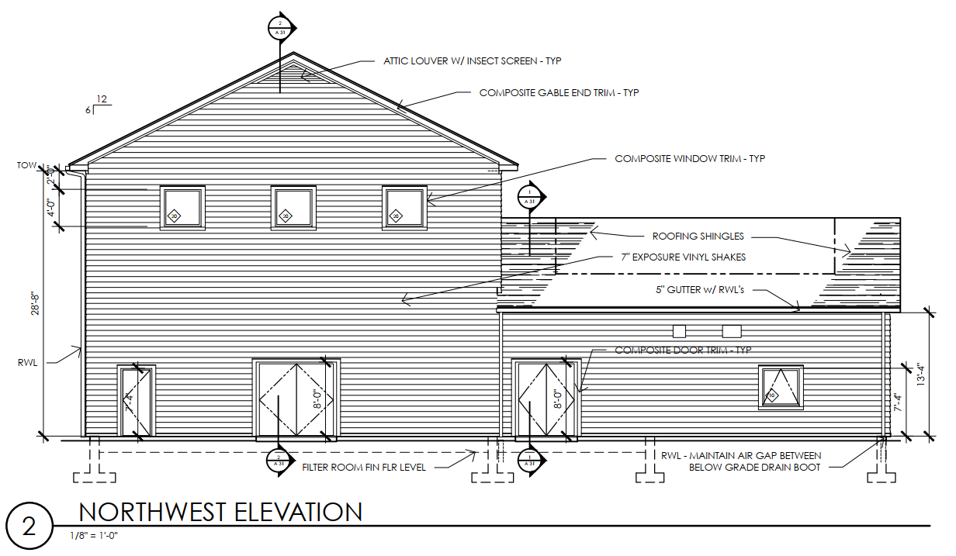

Slide 12
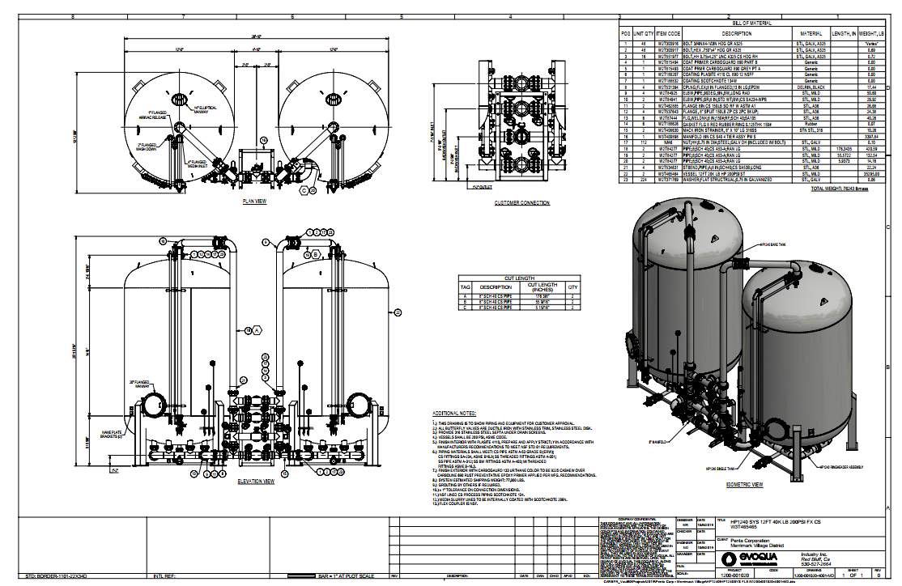
Notes:
UC-1240-LD.
Not Acid Washed.
Bituminous based
Can be regenerated
Lignite is wood based coal

Slide 13
Wells #7 and #8

Slide 14
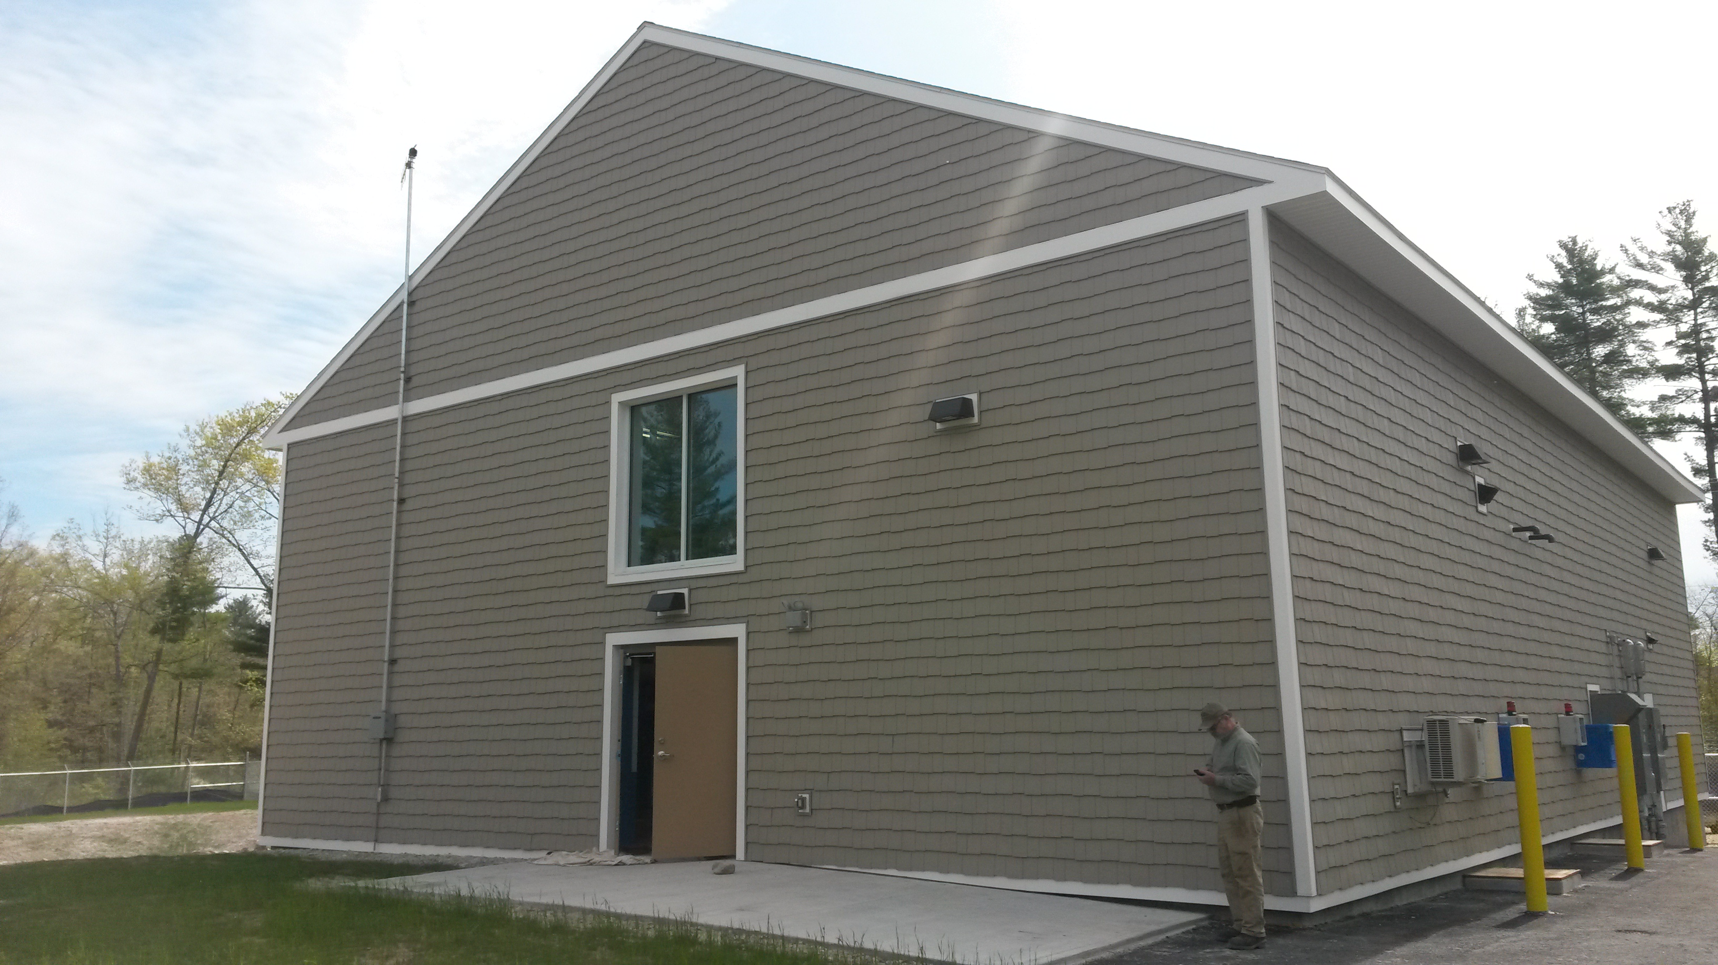
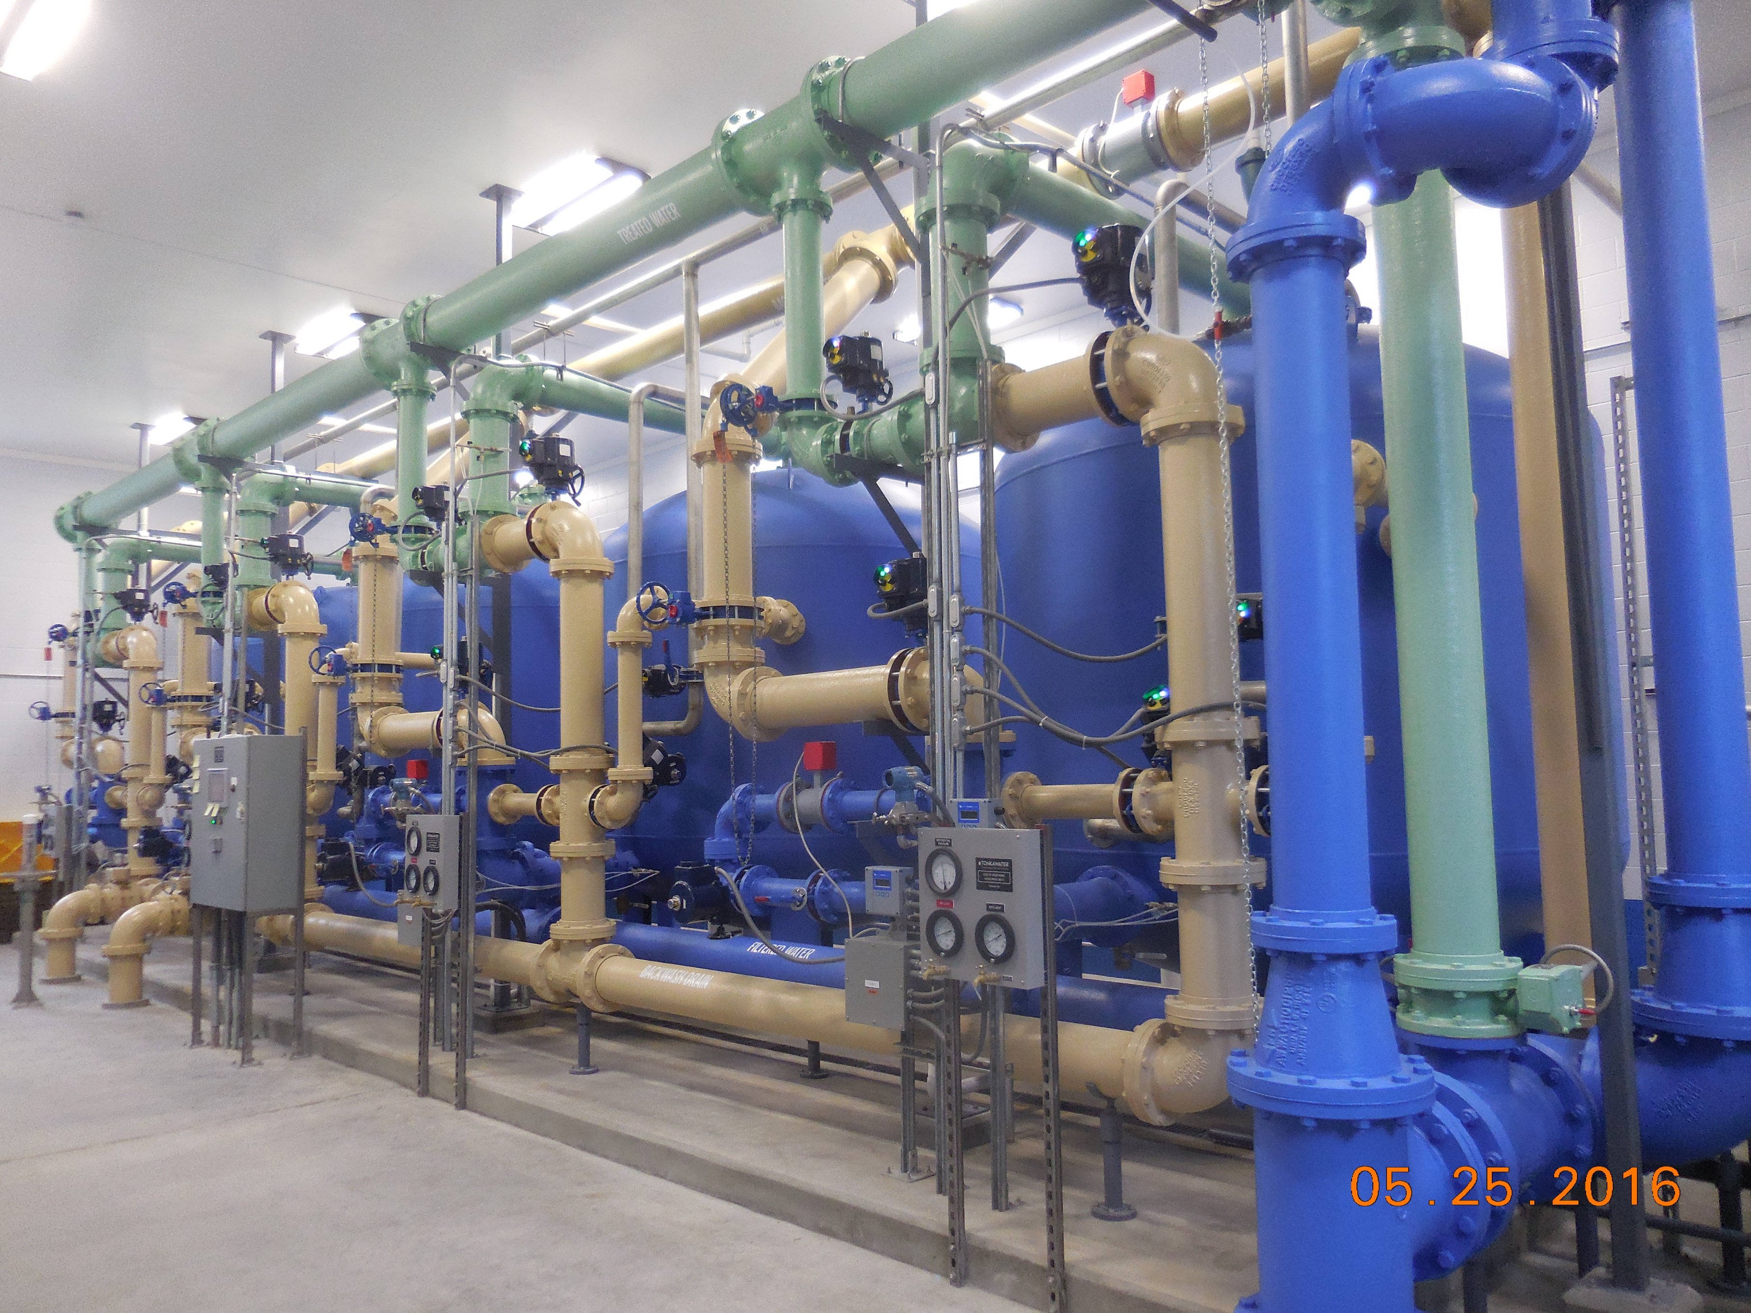
Existing Treatment Plant - #7/#8

Slide 15
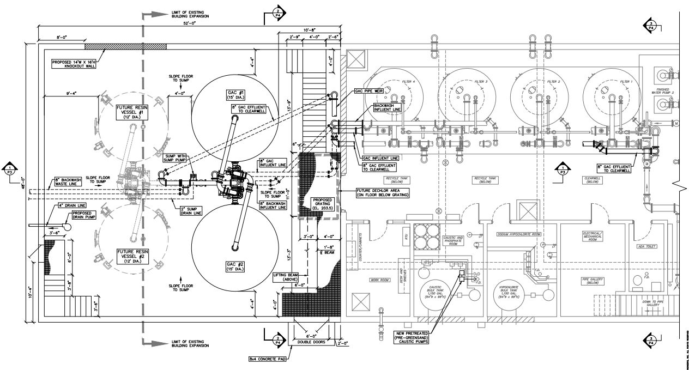
Well 7 & 8 Addition

Slide 16
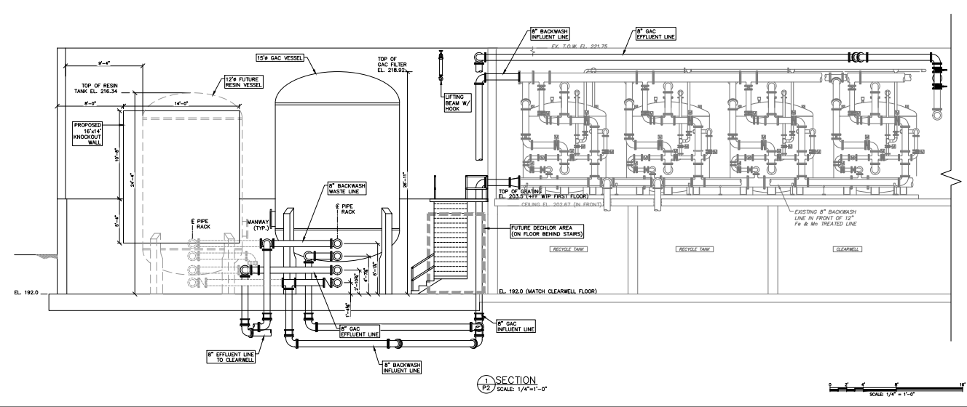
Well 7 & 8 Addition

Slide 17
Wells #2 and #3

Slide 18
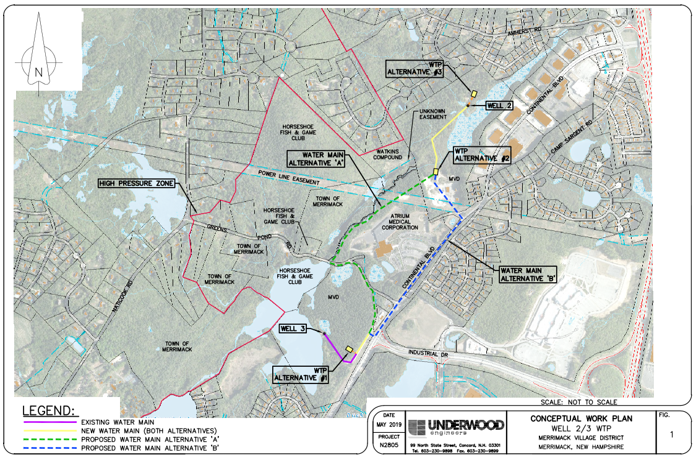
2
1-1/4 miles Raw Water Transmission Main
3

Slide 19
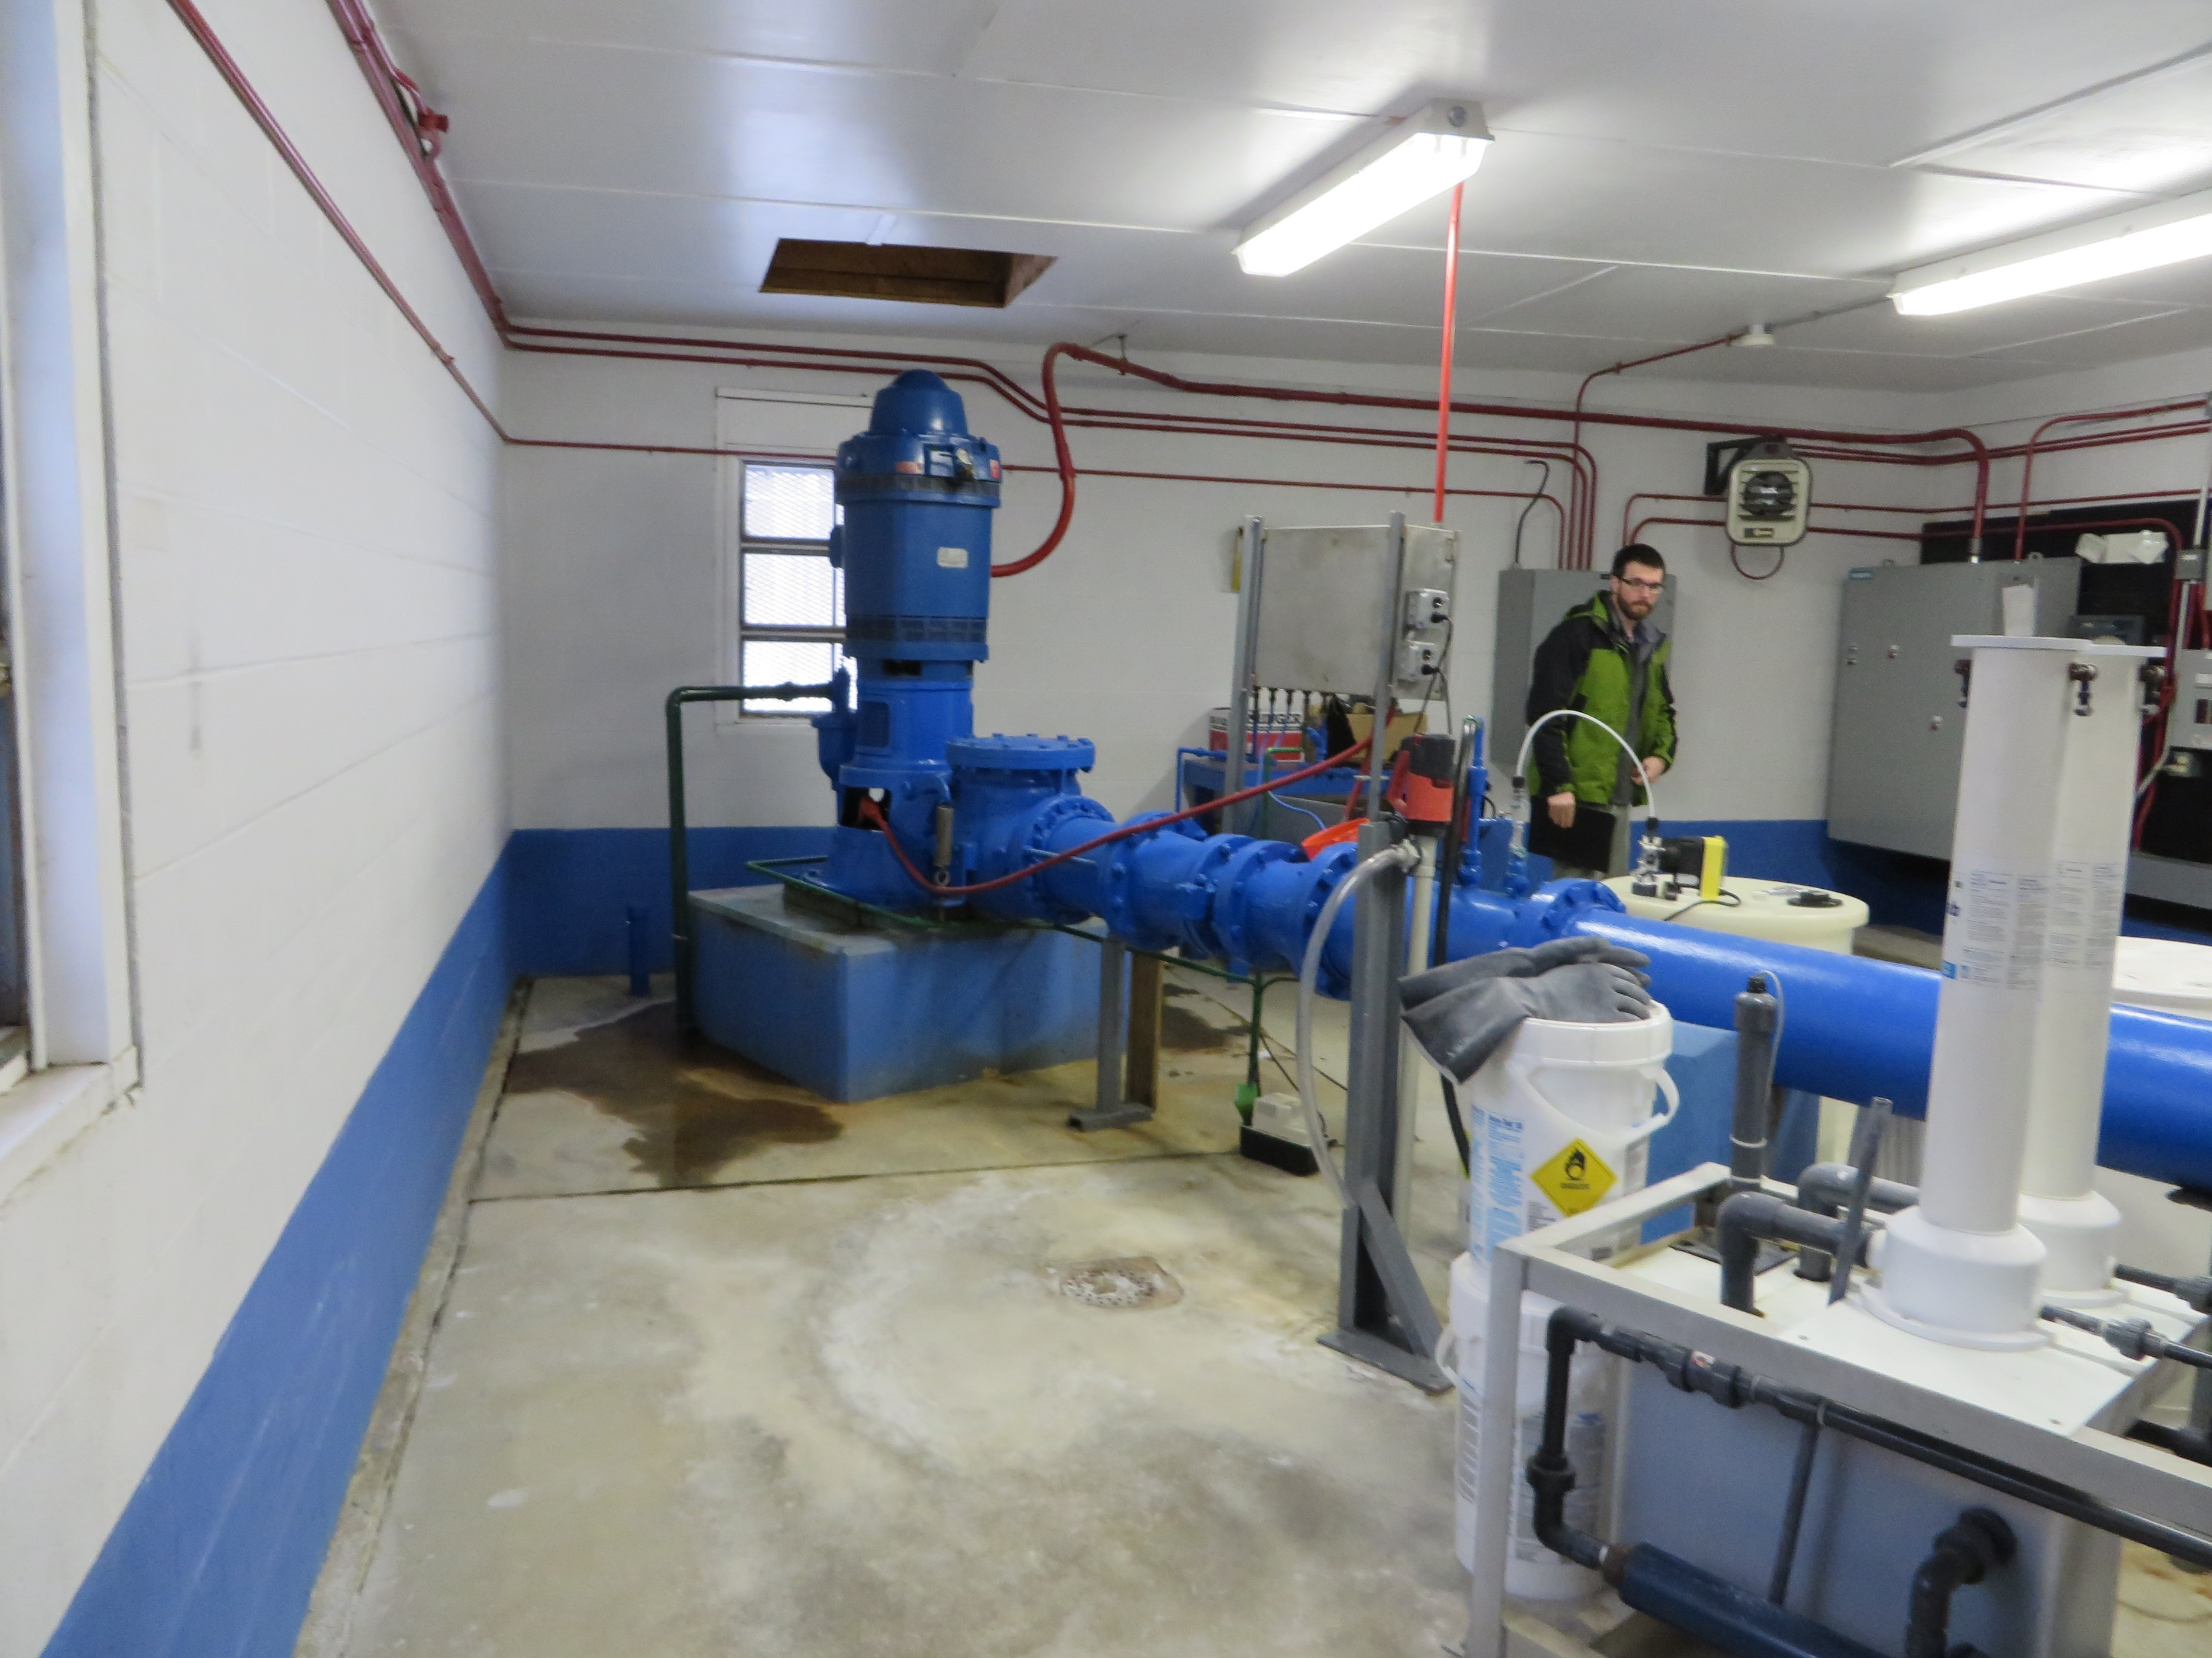
Well #2

Slide 20
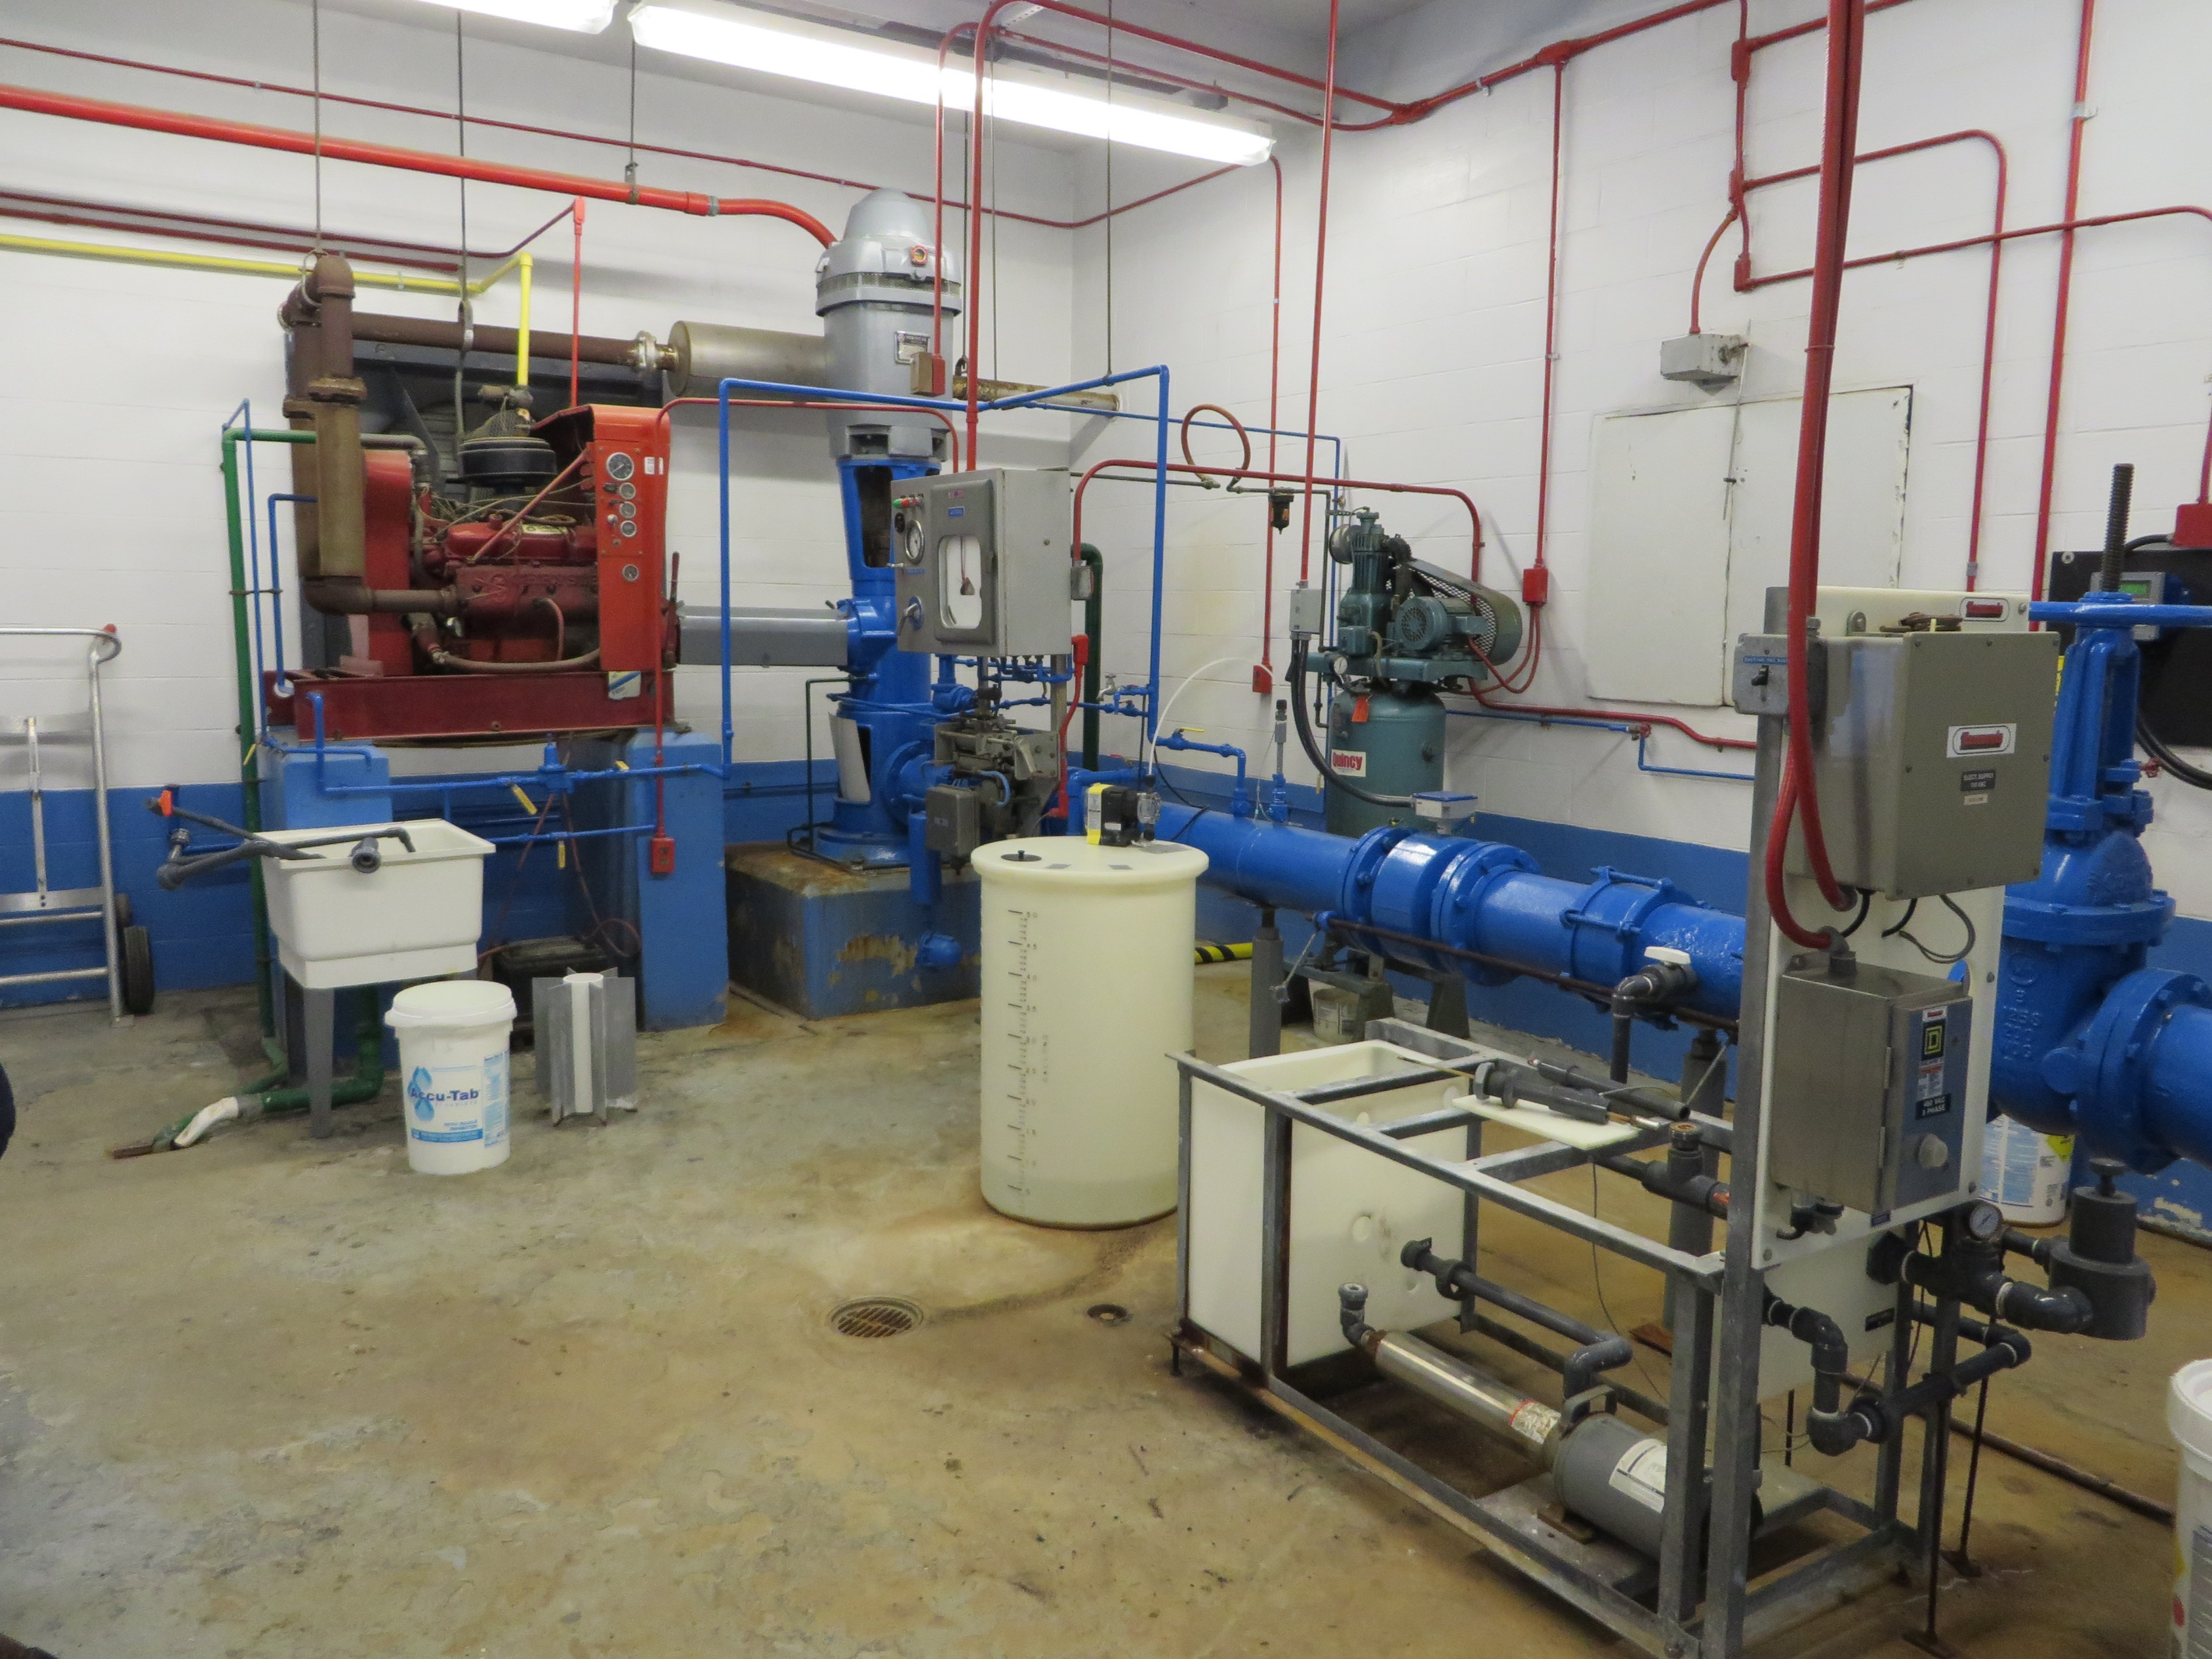
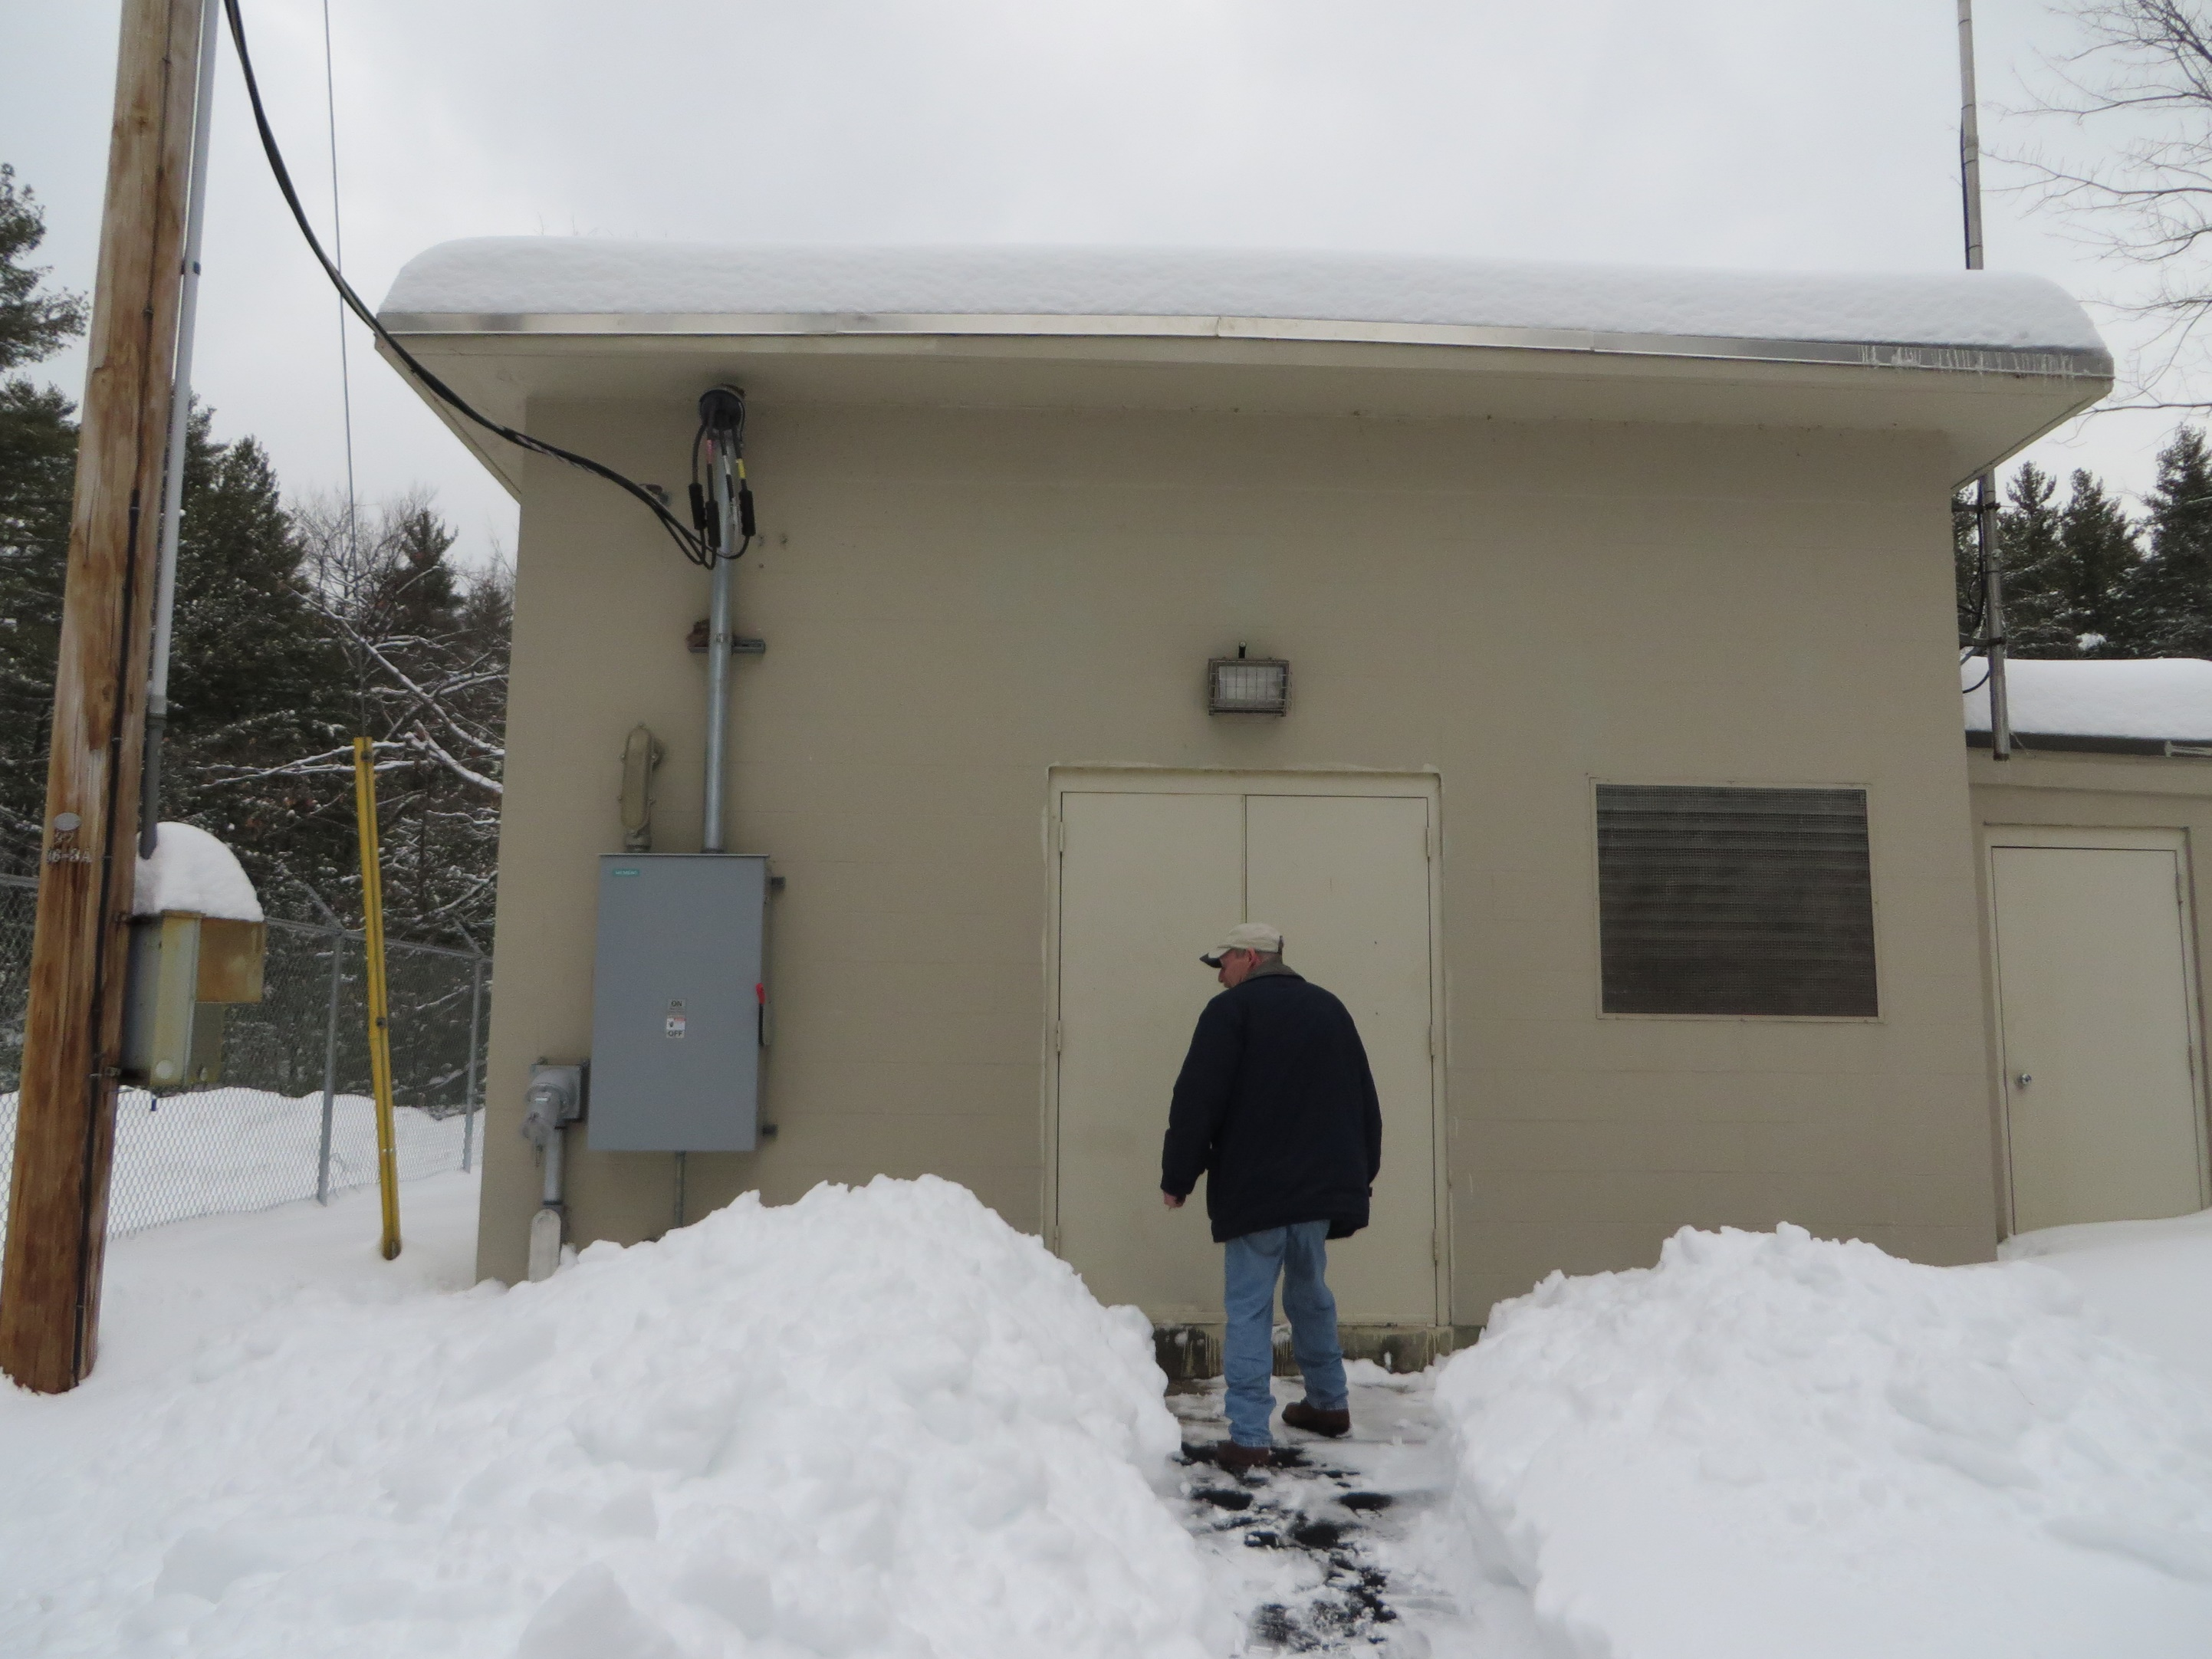
Well #3

Slide 21
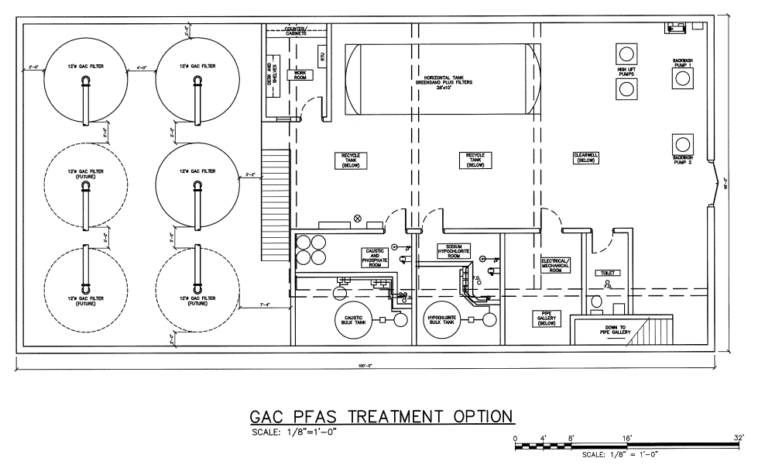
Well #2 & #3 Fe/Mn & PFAS Removal

Slide 22
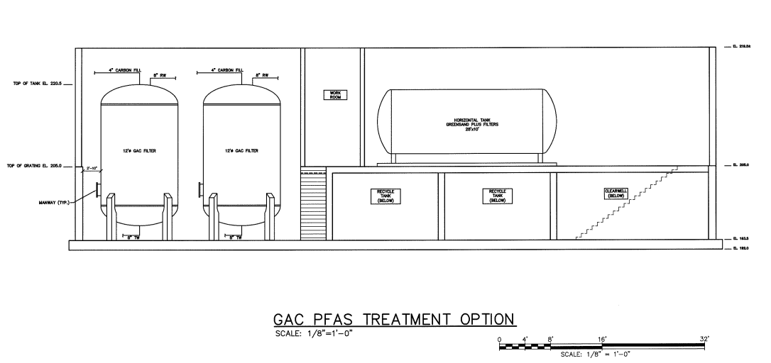
Well #2 & #3 Fe/Mn & PFAS Removal

Slide 23
Schedule

Slide 24
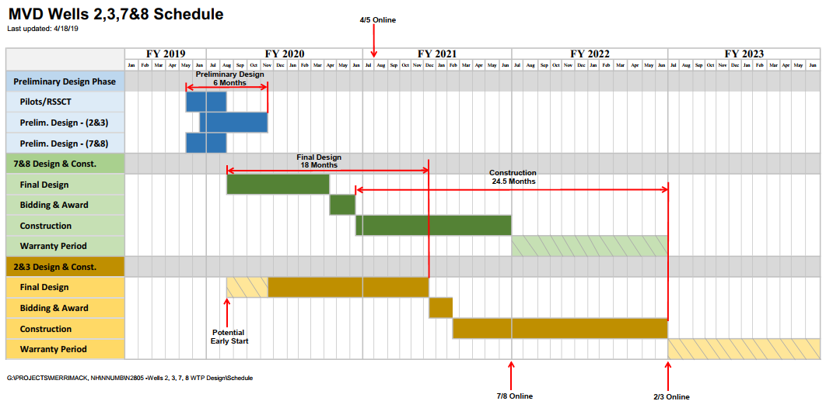
Master Schedule

Slide 25
Systems Online - Target
TODAY
July 2020
July 2022
July 2021

Slide 26
Challenges and Opportunities

Slide 27
Funding
Wells #2/#3 and #7/#8

Slide 28
Funding Request – May 2019 #2, #3, #7, and #8
Source | Request
DWGWTF Loan | $6,264,500
DWGWTF Grant | $1,450,000
DWSRF or NH Municipal Bond Bank | $6,500,000
MVD Capital Reserves | $285,500
TOTAL | $14,500,000

Slide 29
Piloting and RSSCT
Fe/Mn and GAC

Slide 30
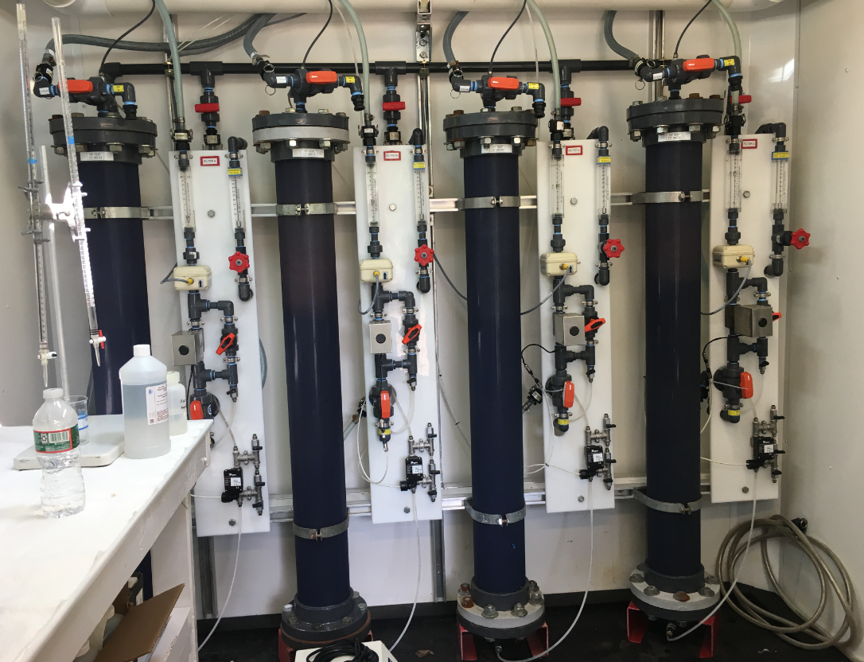
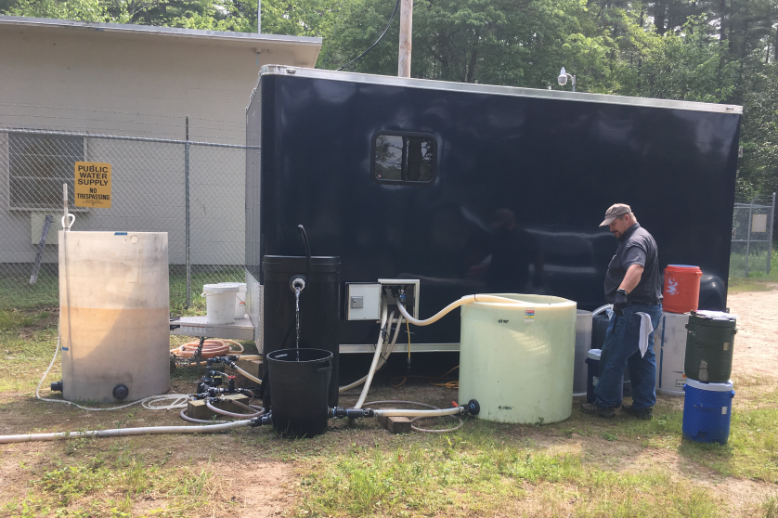

Slide 31
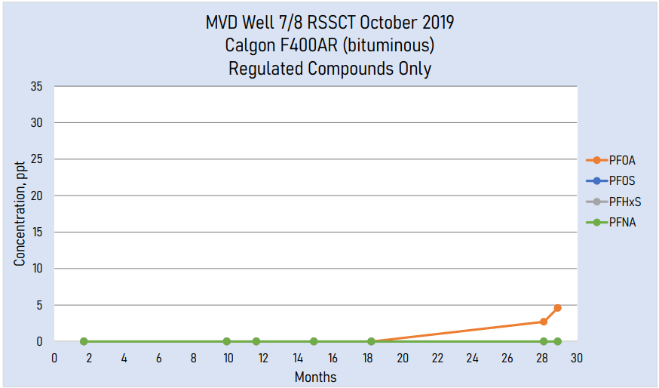
Notes:
KSD – 1-year pilot
Westfield – RSSCT
Pease – 1-year pilot
Hoosick -

Slide 32
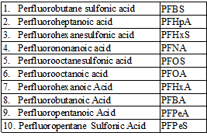
Evaluating Short Chain Too
Notes:
8-10 months breakthrough

Slide 33
GAC Conditioning

Slide 34
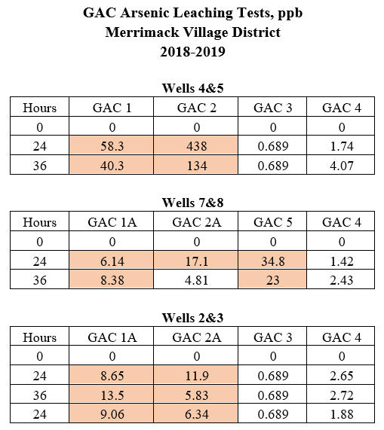
GAC Conditioning

Slide 35
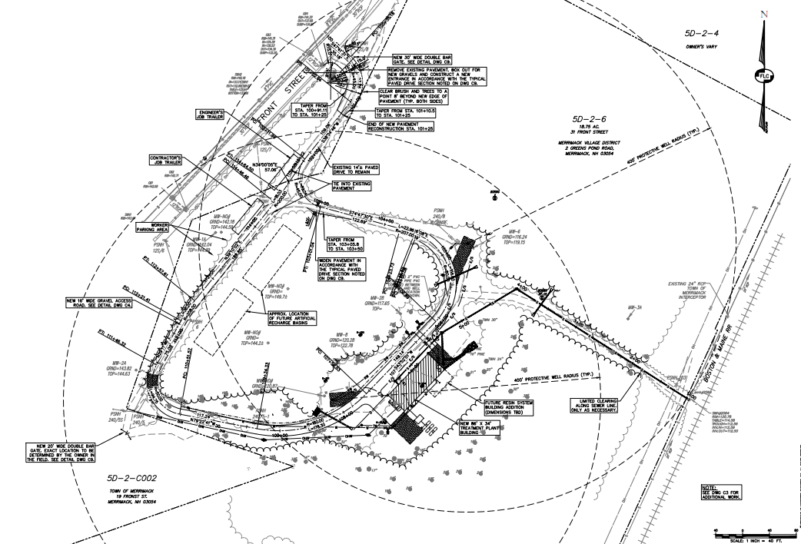
W
Basin
TP
W

Slide 36
New MCL’s
Wells #2/#3 and #7/#8

Slide 37
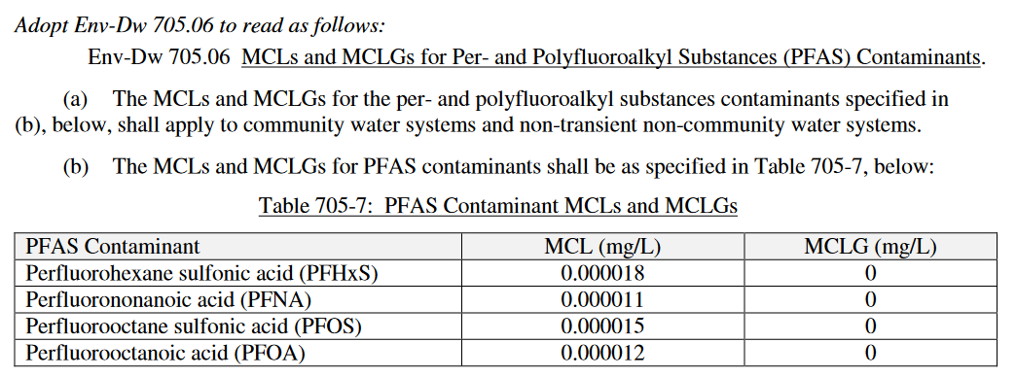
New MCL’s
NH just adopted new administrative rules July 19, 2019
Drinking Water Standard
Ambient Groundwater Quality Standard

Slide 38
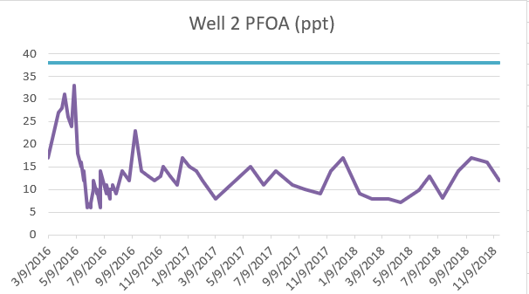
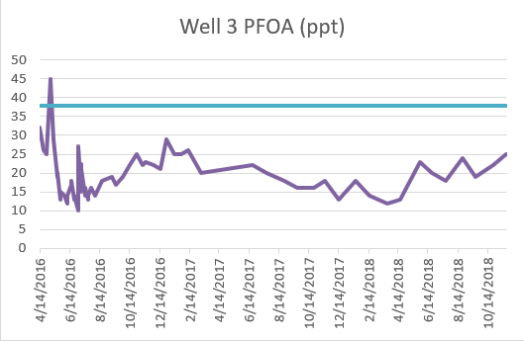
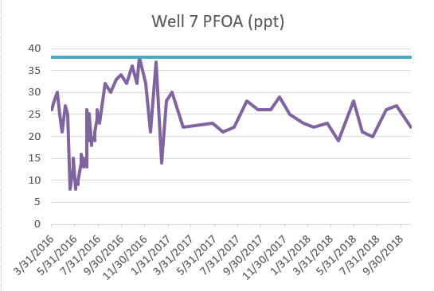
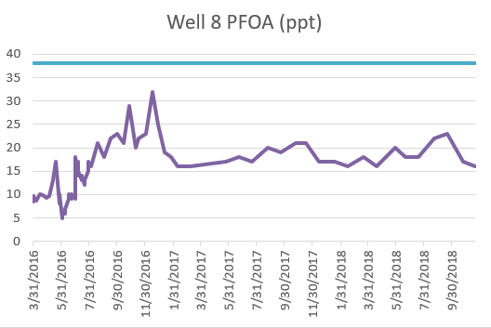
PFOA Concentration History

Slide 39
Impact of New Standards
Now a regulatory requirement to treat
Lag Vessels Required
Larger WTP’s
Preliminary estimate – add $3 million

Slide 40
Well 7 & 8 Addition

Slide 41
Current Capital Projects - Increases
Project | Budget | Additional
Turkey Hill Booster | $1,300,000
Wells #4 and #5 PFAS | $4,160,000 | $1,000,000
Wells #7 and #8 PFAS | $3,600,000 | $1,500,000
Wells #2 and #3 PFAS | $6,400,000 | $1,500,000
Wells #3 Fe/Mn | $4,500,000
TOTAL | $19,960,000 | $4,000,000
Total = $24.0 M
PFAS = $18.2 M

Slide 42
Technical Review
UNH

Slide 43
Commissioner Comments

Slide 44
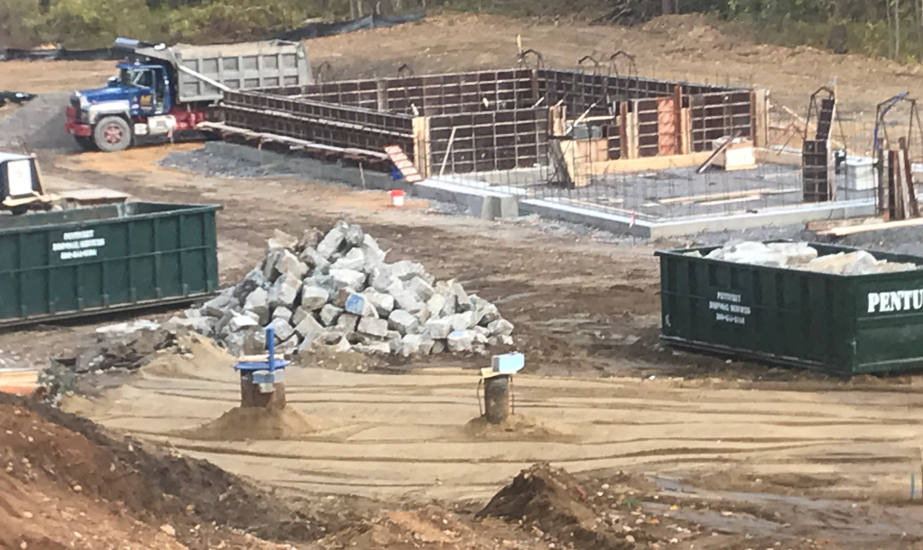
Questions?

